Slide 1

Introduction to Databases
and Data Storage Technologies
April 7, 2021
Dr. Carl Stahmer
Executive Director, UC Davis DataLab
Notes:
BALA

Slide 2
datalab@ucdavis.edu

Slide 3
Learning Objectives
Compare and contrast different data storage platforms;
Explain the difference between SQL and noSQL databases;
Explain the components of an Entity Relationship Diagram (ERD)
Define Relational Keys;
Identify appropriate data storage solutions based on the structure of a research dataset.
Notes:
CARL
6 startup projects: Epidemiology - Beatrice Lopez, VetSchool Liver Cancer, Cardiology, Alzheimer's, Geomorphology - Magali (3D viz) Eugenics - Emily Merchant Political Experts - Stephanie Mudge (Sociology)
Ongoing internal research projects: Quintessence, COVID Docs
Collaborative funded projects: WateReview - Sam Sandoval Solis, LAWR (S America) Science in Gov’t Policy - Tyler Scott (ESP)** Micromobility - Transportation Institute EBBA, Getty, Hack4CA - Lindsay Poirier Secure Computational Pipelines, Cardiology, Pediatric Diabetes

Slide 4
Learning Objectives:
MacKenzie Smith, Vice Provost of Digital Scholarship
Carl Stahmer, DataLab Executive Director
Pamela Reynolds, DataLab Associate Director
Bala Rajaratnam, Scientific Director (Statistics)
Titus Brown, Director for Community Initiatives (Veterinary Medicine)
Vladimir Filkov, Director for Translational Data Science (Computer Science)

Slide 5

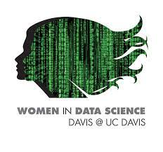

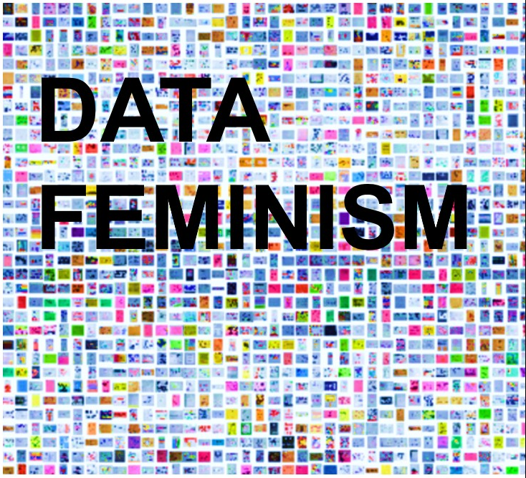

Updates: Training
Winter by the numbers
11 workshops
905 registrations; 633 unique learners
37% grad students & postdocs; 26% staff; 4% faculty; 7% alumni & other
53% she/her, 24% he/him, 2% other; 21% unreported
9 UCs, 3 CSUs, 14 other univ., 9 other institutions
Spring Training
GitHub for Teams, Spatial Statistics, R Basics, + more!
Upcoming Community Events
UC LOVE DATA WEEK
Adventures in
SYMPOSIUM
May 12, 2021
Computational Pedagogy Talk Series
Notes:
PAMELA

Slide 6
Updates: Integrating your feedback
RESEARCH
Researcher toolkits
TRAINING:
Developed and implemented standardized post-workshop surveys
Conducted interviews with CA Data Election Challenge (hackathon) participants; more alumni engagement planned
Microcredentials (including HPC)
COMMUNITY
Outreach to undergraduates
Newsletter
Notes:
So i the learning objectives I talked a ton about metadata.
So metadata is defined as
[READ]
When we talk about creating documentation for a project, or describing your workflow, we're talking about metadata.

Slide 7
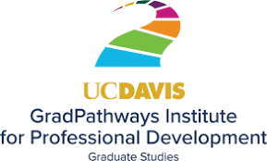
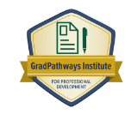
Updates: Microcredentials
Launching fall 2021
Initial pathways
Reproducible research
Intro to scientific computing
Remote computing (HPC, T. Brown)
Data visualization
Planned pathways
Text mining and NLP
Geospatial
Computational pedagogy

Slide 8
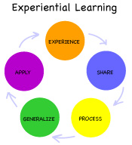
Experiential Learning Needs and Opportunities
How should DataLab grow engagement with hands-on learning to promote student and research goals?
Current DataLab Activities
A Growing Need Across the University
Hackathons
hands-on experience applying skills to a domain problem
Capstone/Project Courses
STA 160, 194; ECS 189, 193; STS 195; MAT 194; HNR 195; and more...
CUREs
course-based undergraduate research experience opportunities
Consulting Courses
STA 260; etc.
Projects/Internships
learning and applying skills to solve research problems
Computational Modules
Notes:
Increasing University priority: students to have experiential learning opportunities.
DataLab has approached this with hackathons, teaching CURE courses, and providing internships and project-based opportunities.
Across campus, there are a growing number of capstone, project, and consulting courses in statistics, computer science, science and technology studies. These are being taught at the graduate and undergraduate level, and include required and elective courses. The number of these courses, and the students they enroll, will only increase. Other universities farther along with their data science majors and programs, expressed at a recent UC and CSU -wide CA data science education conference that support for these capstone courses is a major obstacle. Today we will focus on these courses specifically, and we can return to DataLab services as part of the broader EL mission at a later meeting.

Slide 9
Experiential Learning Needs and Opportunities
Bringing together untapped resources to increase data science training opportunities and research partnerships
A Growing Need Across the University
Students
hands-on applied experience
career-skills training
Instructors
identify, vett, connect with suitable projects and partners
Capstone/Project Courses
STA 160, 194; ECS 189, 193; STS 195; MAT 194; HNR 195; and more...
Consulting Courses
STA 260; etc.
Domain Researchers
identify and pilot methods, approaches, etc. for data-driven research problems
Notes:
BALA
Instructors of these courses need to identify, vett, and connect with suitable projects and partners to provide their students with authentic, applied learning experiences.
Meanwhile there is a strong demand for Data Science Consulting and Collaboration on campus (way more than current resources permit). Insatiable demand driven by both traditional and emerging data savvy disciplines. Advisory group may relate to it: you would have liked quick data science input or even more long-term collaboration on data science projects. Given our current bandwidth, are there any obvious and strategic ways in which we can expand our outreach and increase impact ?
Can we bring together these untapped resources on campus and leverage the synergies? And consequently, increase data science training opportunities and research partnerships significantly?

Slide 10
Experiential Learning Needs and Opportunities
Bringing together untapped resources to increase data science training opportunities and research partnerships
A Growing Need Across the University
Students
hands-on applied experience
career-skills training
Instructors
identify, vett, connect with suitable projects and partners
DataLab
“enable data-driven research and hands-on training”
Capstone/Project Courses
STA 160, 194; ECS 189, 193; STS 195; MAT 194; HNR 195; and more...
Consulting Courses
STA 260; etc.
Domain Researchers
identify and pilot methods, approaches, etc. for data-driven research problems
Notes:
DataLab “matchmaking” service to facilitate data-enabled research and education. Goal is to connect the untapped skills from core quantitative data science disciplines to elevate research across the entire university.

Slide 11
Experiential Learning Needs and Opportunities
Bringing together untapped resources to increase data science training opportunities and research partnerships
Informal Pilot & Matchmaking
Students
hands-on applied experience
career-skills training
Instructors
identify, vett, connect with suitable projects and partners
ECS 193
ECS 189
STA 260
DataLab
“enable data-driven research and hands-on training”
Domain Researchers
identify and pilot methods, approaches, etc. for data-driven research problems
Notes:
Pamela piloted this via connecting projects (including both DataLab internal projects that we haven’t had bandwidth to tackle) and projects of our faculty affiliates with ECS 193, 189, and consulting course STA 260. For the consulting course, it also included meeting with the students, and having them shadow DataLab’s weekly drop-in office hours so they could observe how we handle short-term consulting engagements.
DataLab could support a more formalized experiential learning project matchmaking service.

Slide 12
Experiential Learning Needs and Opportunities
Bringing together untapped resources to increase data science training opportunities and research partnerships
Benefits
win-win for research partners (domain faculty), data science consultants (students), and instructors (core data science faculty)
Students
hands-on applied experience
career-skills training
Instructors
identify, vett, connect with suitable projects and partners
DataLab
“enable data-driven research and hands-on training”
Challenges
relationship management
project identification, prioritization, scoping
participant orientation, training
requires resources (personnel, infrastructure, etc.)
Domain Researchers
identify and pilot methods, approaches, etc. for data-driven research problems
Notes:
Identified Benefits
Proof-of-concept: Research collaborations led to significant output
Win-win for both “research partner” and “data science consultant”
Challenges
students don’t always produce deployable-ready results, often it’s exploratory; careful relationship management for domain researchers and instructors/students critical
time intensive to identify and scope potential projects; also equitability issues of who gets help, how projects are prioritized
Where we are at:
Brainstorming discussions among DataLab Directors (BR, TB, VF, PR, CS) and Vice Provost (MS)
Concept Note/ Proposal currently being written up
Should we continue to do this in an ad-hoc way, or scope for institutionalizing this training opportunity and research collaboration?

Slide 13
Experiential Learning Needs and Opportunities
Is an institutionalized instructor-project matchmaking service a strategic training opportunity DataLab should pursue?
As users of data science, how great is this unmet demand?
What are additional strengths and drawbacks?
Do you have any prior experience in this space that we can learn from?
If so, how can we make it a success?
What resources should we be looking for to support this service?
What is the best way to engage academic units / departments?
Do we need another pilot?
Notes:
Identified Benefits
Proof-of-concept: Research collaborations led to significant output
Win-win for both “research partner” and “data science consultant”
Challenges
students don’t always produce deployable-ready results, often it’s exploratory; careful relationship management for domain researchers and instructors/students critical
time intensive to identify and scope potential projects; also equitability issues of who gets help, how projects are prioritized
Where we are at:
Brainstorming discussions among DataLab Directors (BR, TB, VF, PR, CS) and Vice Provost (MS)
Concept Note/ Proposal currently being written up
Should we continue to do this in an ad-hoc way, or scope for institutionalizing this training opportunity and research collaboration?

Slide 14
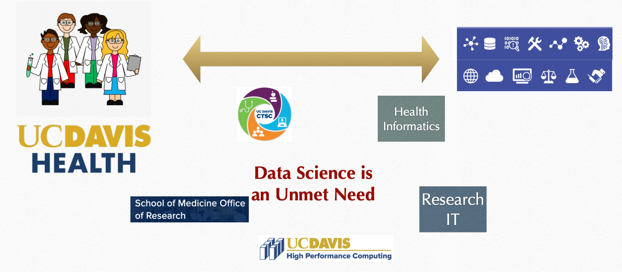
Facilitating Health Data Science Innovation
How can DataLab scale to best meet the many opportunities and need at UCDH?

Slide 15

Facilitating Health Data Science Innovation
What we’re doing now: HDSS Cluster
Health Science & Systems RLC focuses on:
Data science methods (ML/AI/NLP/mining/stats/simulations/etc.)
Data science systems (pipelines, data security, synthetic data)
Community connections, training
People
faculty V. Filkov; N. Anderson, S. Peisert
50% data scientist; 2 GSRs; volunteer affiliates
Current and Immediate Future Services
office hours
consultations
start-up projects
workshops
collaborations (grants and ad-hoc projects)
coming soon: recharge basis (core-like function)
Fridays 11:30-1pm
https://datalab.ucdavis.edu/health-data-science-sstems/

Slide 16
Facilitating Health Data Science Innovation
What we’re seeing (Winter 2021):
Medical image analysis
Clinical studies (collection, storage, cleaning)
Patient record analysis (NLP)
Patient monitoring
Predictive analytics and forecasting (integrative solutions, dashboards)
Genomic analysis
Geocoding
Social media analysis
Notes:
image: liver, brain
clinical: data collection, storage, cleaning
genomic analysis (tuberculosis)
geocoding and social media analysis (epidemics)

Slide 17
Facilitating Health Data Science Innovation
How can DataLab scale to best meet the endless opportunities and need at UCDH?
Needs
Staffing expertise: image, signal, genomic, NLP
Anticipate capacity: for short and long term projects
Vertical integration: data scientists, postdocs, GSRs
Establish and maintain synergies: CTSC, Health Informatics, Research IT, HPC, Blaisdell, etc.
DataLab Expansion into UCDH: White Paper

Slide 18
Concluding Remarks
Next meeting: Mid- to late May 2021
Meeting summary: To be circulated
Thank you !

Slide 19

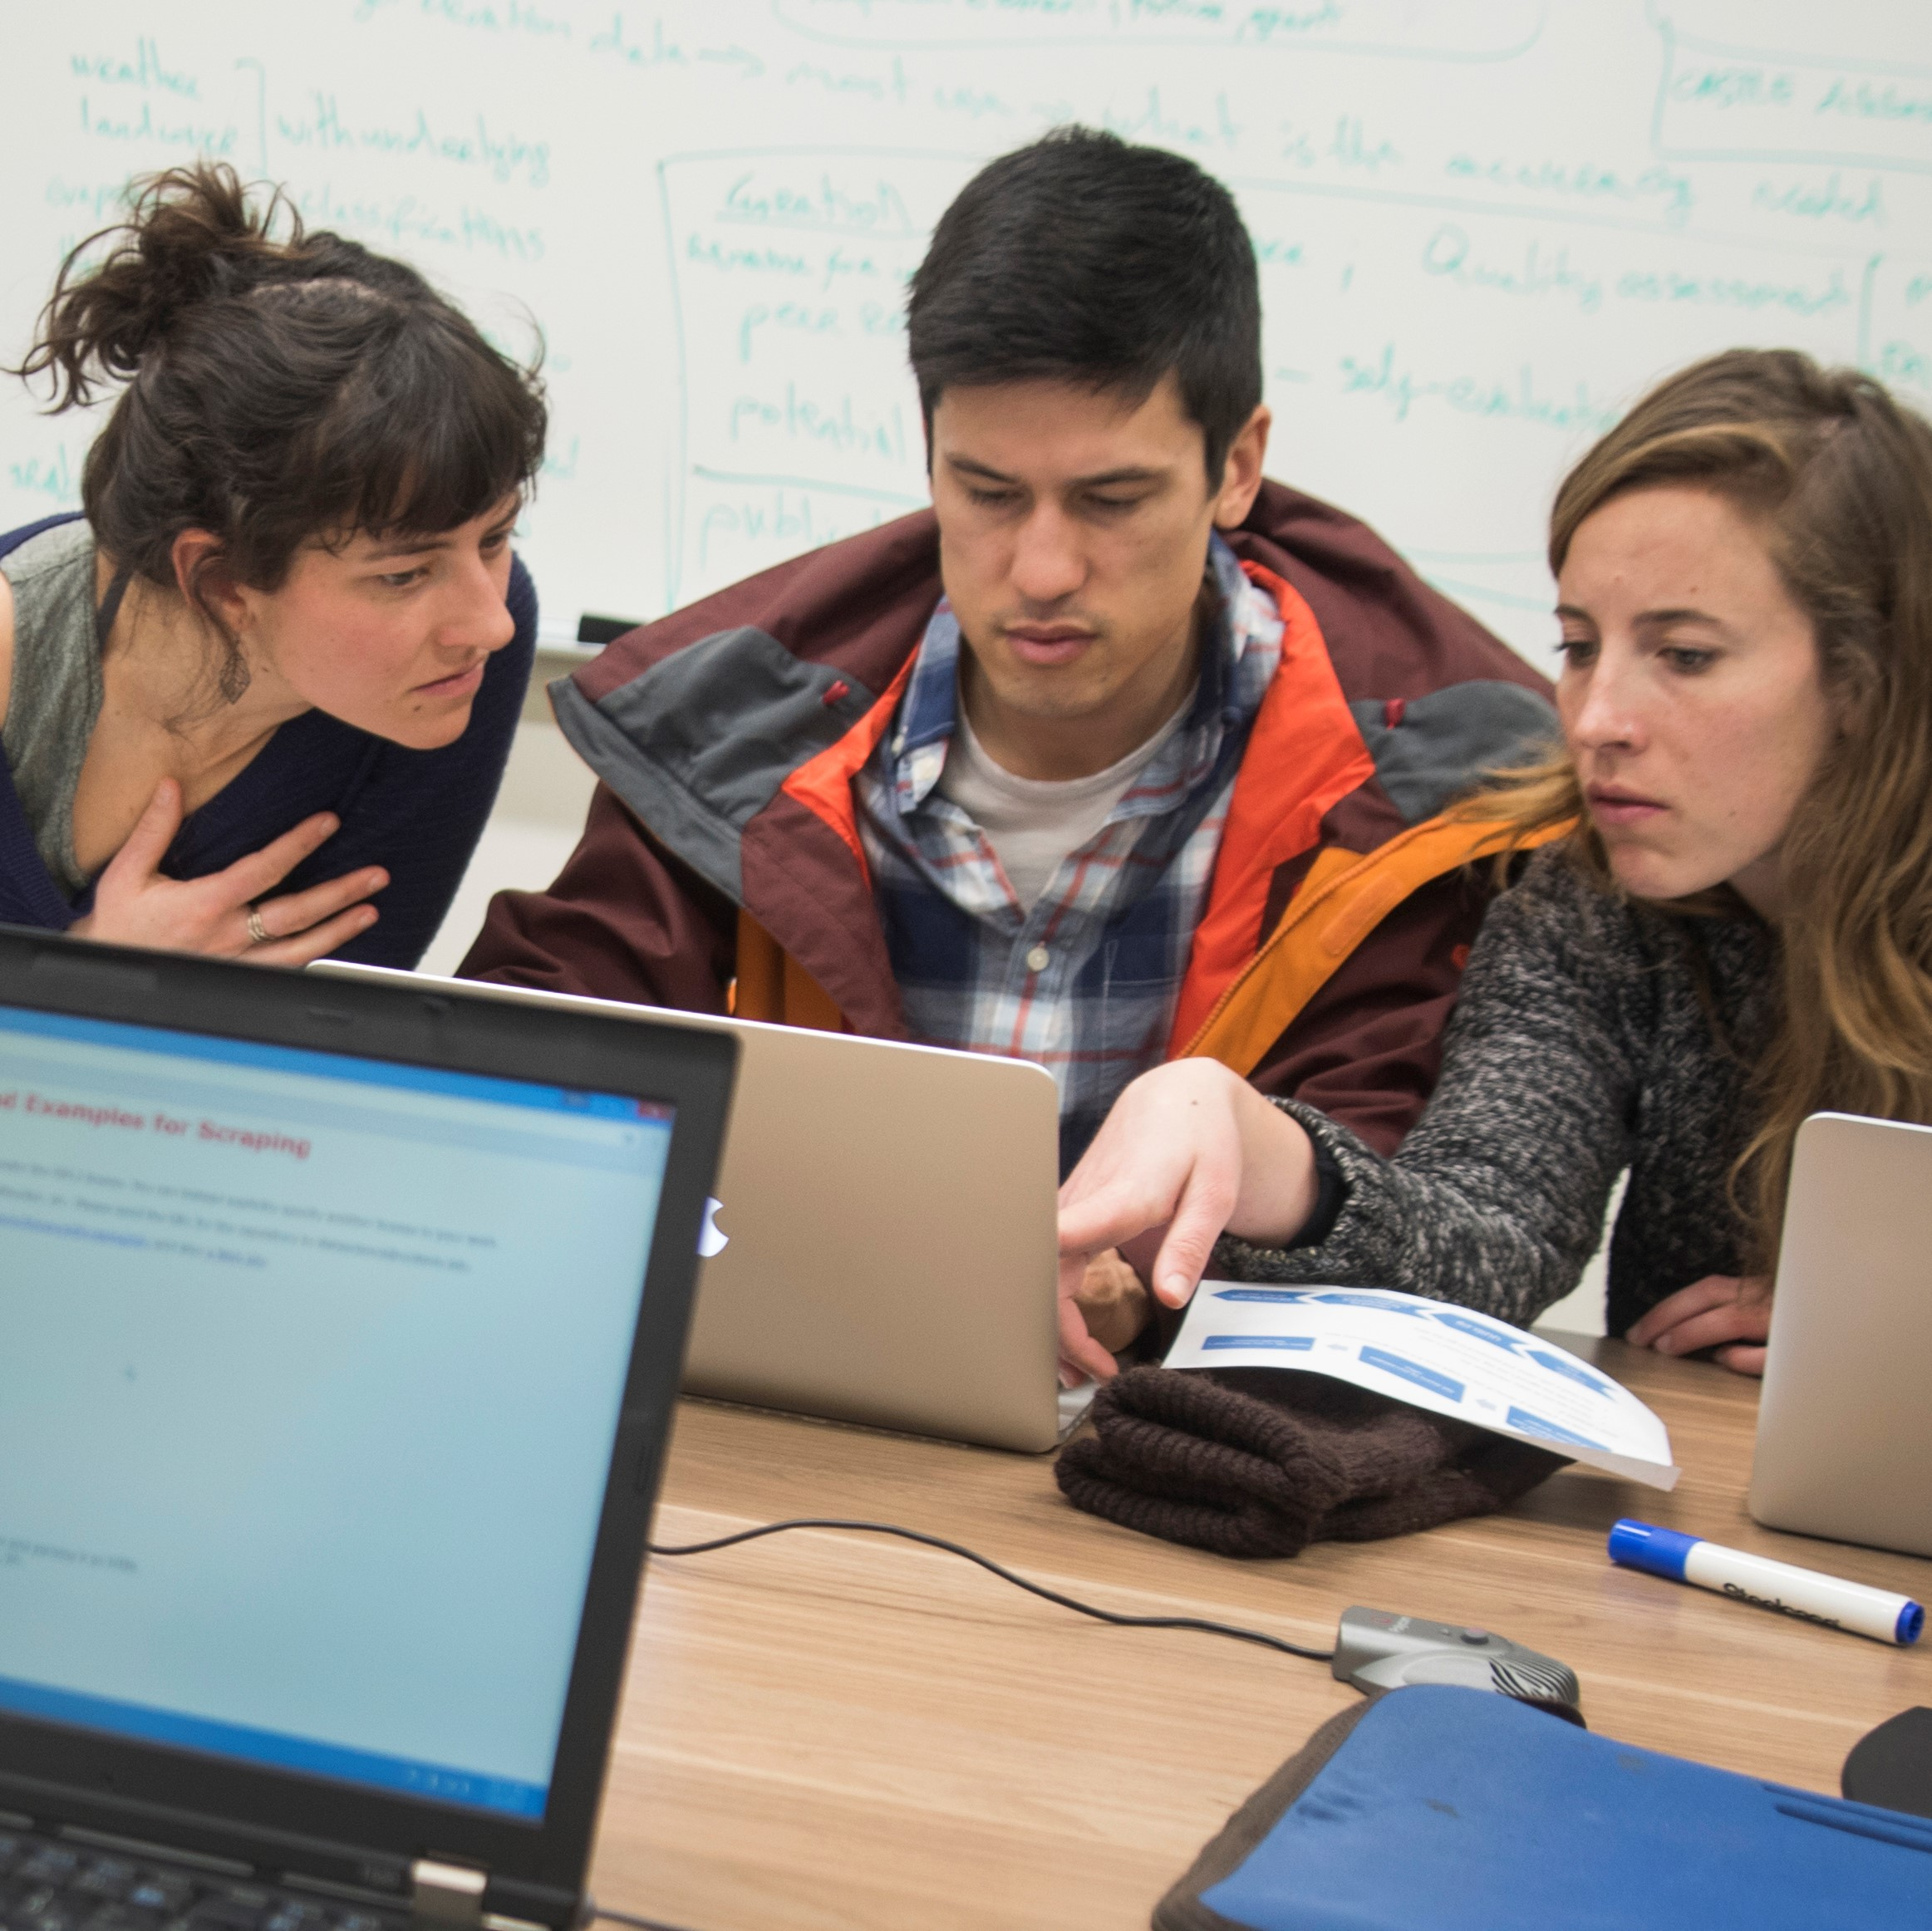
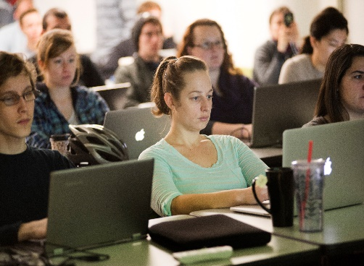
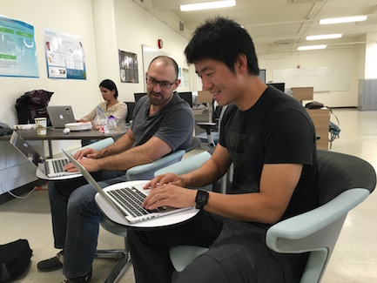
Supporting innovation, accelerating data-driven discovery
https://datalab.ucdavis.edu/
core services & activities
RESEARCH
»» Increase UC Davis’ research impact via data-driven expertise.
» Work
Office hours
Consultations
Preliminary report services
Projects
Collaborations
TRAINING
»» Supporting the next generation of data-capable researchers & students.
» Learn
Workshops
Internships
Experiential learning courses
GSRs, Postdocs
DataFests, Hackathons, Info Sessions
COMMUNITY
»» Foster & coordinate data-enabled researchers, efforts and university units.
» Connect
Research Clusters
Affiliates Program
unSeminars, Seminars, Symposia
Advisory Services
Networks & Partnerships
Notes:
DataLab focuses on the application and development of data science tools, methods and thinking to solve real-world research problems.
RESEARCH
No cost weekly office hours and consultations for university researchers (honors students, grad students, postdocs, faculty, etc.).
Services for preliminary data interrogation, text mining and NLP, coauthor networks, more to come…
Semi-annual call for projects for intensive, short-term engagement to make rapid progress on an applied research problem.
Collaborative research support on grant-funded projects.
TRAINING
Core skills and emerging topics workshops (5-8/quarter)
Semi-annual Software Carpentry style intro as well as ‘training the trainer’ workshops
In house internships for undergraduate (and some graduate) students
Collaboratively taught course based undergraduate education classes (annual)
Hire and support GSRs, Postdocs
Develop, run, and partner on events where students can apply their skills to a real world problem (quarterly Datafests, Hackathons, etc.)
Info sessions – “becoming a data scientist,” “doing a data science internship as a graduate student”, etc. in collaboration with Graduate Studies and the Internship and Career Center.
COMMUNITY
Support thematic “Research Clusters,” build data science capacity by connecting domain-based expertise with computational tools, methodologies and data discovery. Current clusters: Hack for California (data science for social good, Prof Lindsay Poirier), Spatial Sciences (Prof Robert Hijmans & Dr. Michele Tobias), Digital Humanities (Prof Carl Stahmer). Also formally support user groups – D-RUG and D-PUG. Groups meet at least biweekly to make progress on one or more projects.
Affiliate programs for graduate students and postdocs, and faculty. Currently a network of 100+ from all 4 Colleges and 4 Schools at UC Davis.
Organize and run local symposia. Winter 2019 will be the 2nd annual Women in Data Science – Davis.
Quarterly networking events.
Support and engage in local workshops, meetings, etc. on relevant themes.
Perform advisory and support services for university units (HPC, Research Computing, etc. working groups).
Liaise with industry, government, NGOs, etc.

